Slide 1


Social Buzz
Analysis
On Power BI

Slide 2


Today's agenda
Project recap
Problem
The Analytics team
Process
Insights
Summary

Slide 3

Social Buzz is a fast growing technology unicorn
that need to adapt quickly to it's global scale.
Accenture has begun a 3 month POC focusing on
these tasks:
• An audit of Social Buzz's big data practice
• Recommendations for a successful IPO
• Analysis to find Social Buzz's top 5 most
popular categories of content
Project Recap

Slide 4


Problem
Every day over 100,000 pieces of content, ranging from text, images, videos and GIFs are posted.36 500 000 pieces of content
per year!
All of this data is highly unstructured and requires extremely sophisticated and expensive technology to manage and maintain.
Analysis to find Social Buzz's top 5 most popular
categories of content

Slide 5



Andrew Fleming
- Chief Technical Architect
The Analytics team
Marcus Rompton
- Senior Principle
Sagar Dodamani
- Data Analyst

Slide 6
Process
1
Data Understanding
2
Data loading and cleaning
3
Data Modelling
4
Data Analysis
5
Uncover Insights

Slide 7

Insights
16
1897
Jan
UNIQUE
CATEGORIES
REACTIONS TO "ANIMAL"
POSTS
MONTH WITH
MOST POSTS

Slide 8
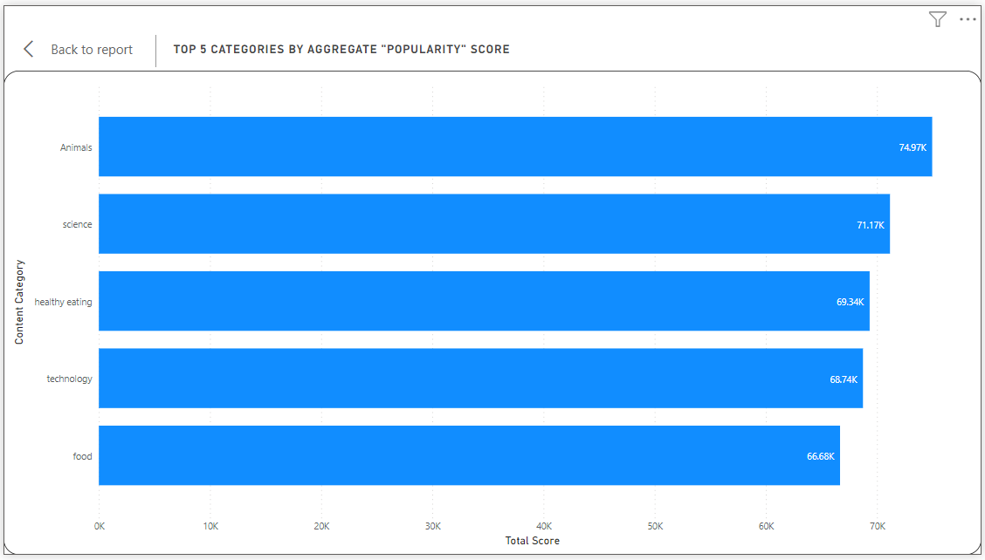

Slide 9
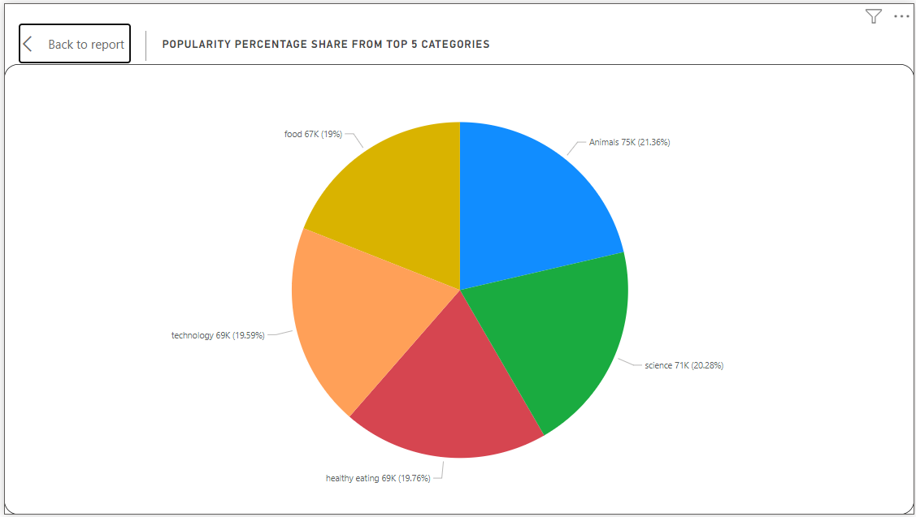

Slide 10

- ANALYSIS
Animals and science are the two most popular
categories of content. showing that people enjoy
“real-life" and "factual" content the most.
- INSIGHT
Food is a common theme With the top 5 categories
with “Healthy Eating” ranking the highest- This may
give an indication to the audience within your user
base. You could use this insight to create a
campaign and work with healthy eating brands to
boost user engagement.
- NEXT STEPS
This ad-hoc analysis is insightful, but it's time to take
this analysis into large scale production for real-time
understanding of your business. We can show you
how to do this.
Summary

Slide 11

Thank you!
ANY QUESTIONS?

